Slide 1
ASP.NET WEB API 2.1
Getting Started
Notes:
https://docs.microsoft.com/en-us/aspnet/core/tutorials/first-web-api?view=aspnetcore-2.1

Slide 2
Content
Architectures
MVC 6
Development Tools
Getting Started

Slide 3
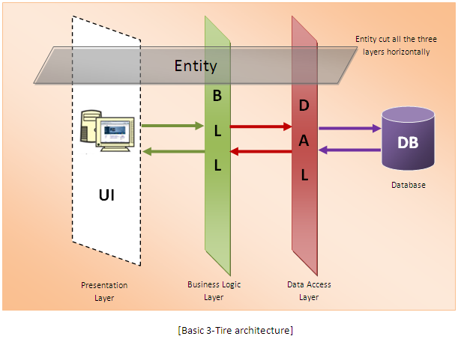
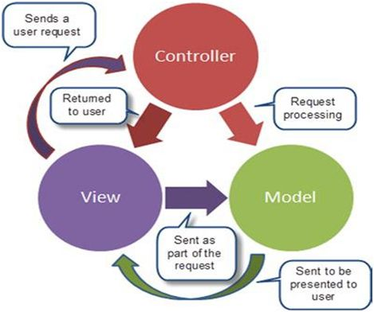
Architectures
3-tier Architecture
MVC Architecture

Slide 4
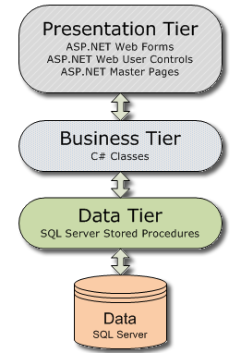
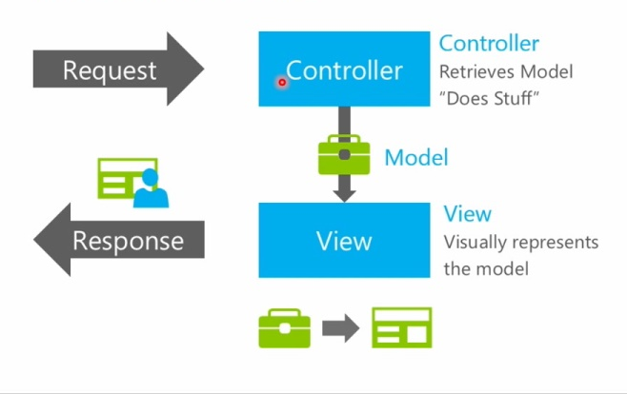
Architectures With ASP.NET
3-tier Architecture
MVC Architecture

Slide 5
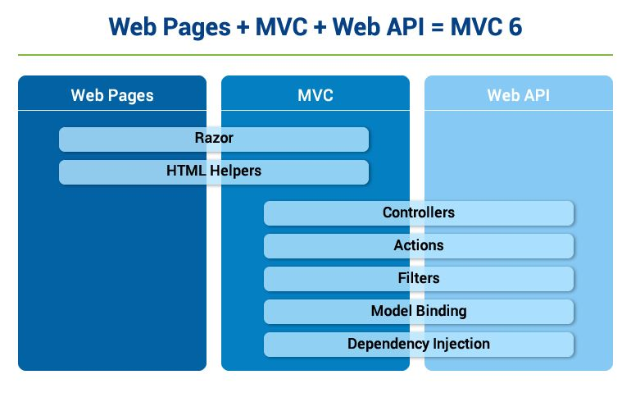
MVC 6

Slide 6
Development Tools
Visual Studio Community 2017
https://visualstudio.microsoft.com/downloads/
https://www.microsoft.com/net/download
SQL Server 2012 Express
https://www.microsoft.com/en-us/download/details.aspx?id=56042
Postman
https://www.getpostman.com/

Slide 7
Getting Started
Overview
Create the project
Launch the app
Add a model class
Create the database context
Prepare Database
Add Connection String to SQL Server
Register the database context
Add a controller
Get to-do items
Implement the other CRUD operations
Search data

Slide 8
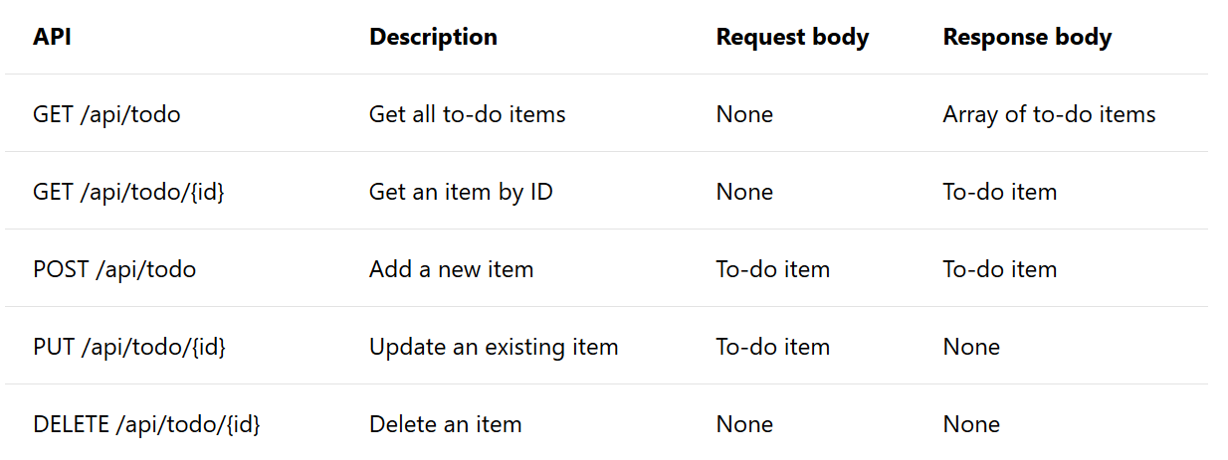
Overview

Slide 9
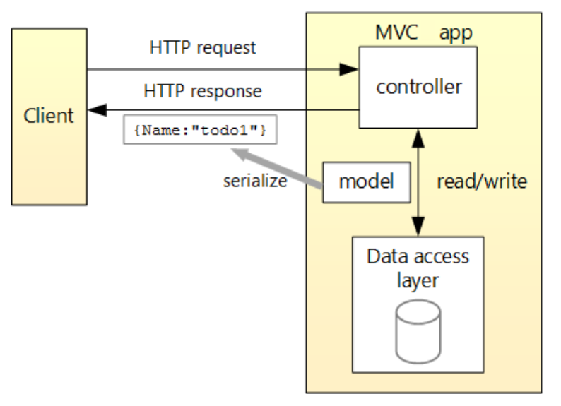

Slide 10
Create the project
From the File menu, select New > Project.
Select the ASP.NET Core Web Application template. Name the project TodoApi and click OK.
In the New ASP.NET Core Web Application - TodoApi dialog, choose the ASP.NET Core version. Select the API template and click OK. Do not select Enable Docker Support.

Slide 11
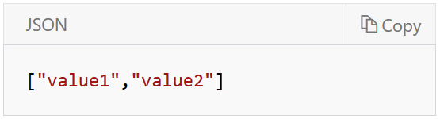
Launch the app
In Visual Studio, press CTRL+F5 to launch the app. Visual Studio launches a browser and navigates to http://localhost:<port>/api/values, where <port> is a randomly chosen port number. Chrome, Microsoft Edge, and Firefox display the following output

Slide 12
Add a model class
A model is an object representing the data in the app. In this case, the only model is a to-do item.
In Solution Explorer, right-click the project. Select Add > New Folder. Name the folder Models.
In Solution Explorer, right-click the Models folder and select Add > Class. Name the class TodoItem and click Add.

Slide 13
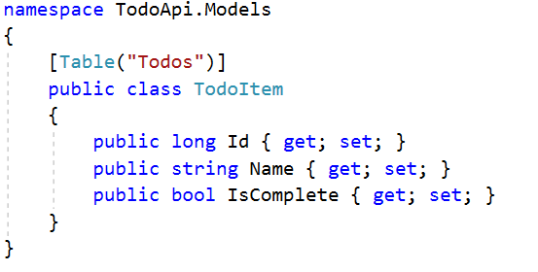
The database generates the Id when a TodoItem is created.

Slide 14
Create the database context
The database context is the main class that coordinates Entity Framework functionality for a given data model. This class is created by deriving from the Microsoft.EntityFrameworkCore.DbContext class.
In Solution Explorer, right-click the Models folder and select Add > Class. Name the class TodoContext and click Add.

Slide 15
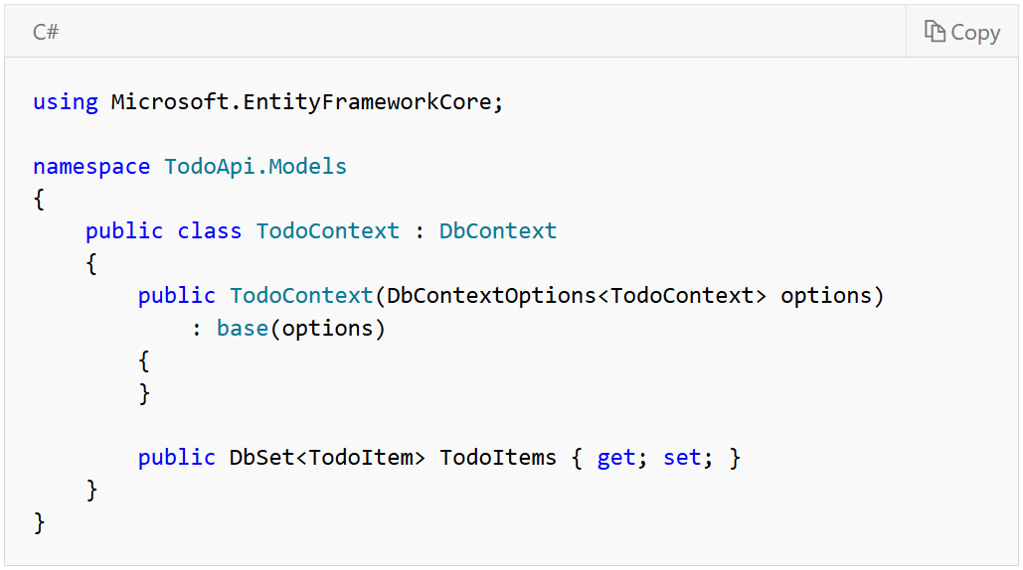

Slide 16
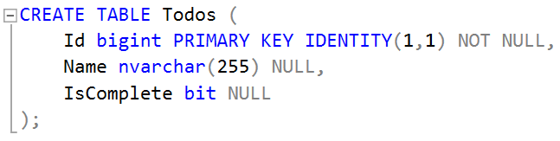
Prepare Database
Create a new database named “TodoApi”
Use below code to create a new table named “Todos”

Slide 17
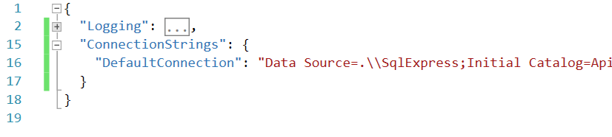
Add Connection String
Open file “appsettings.json”, add connection string like bellow:
Notes:
Data Source=.\\SqlExpress;Initial Catalog=ApiDemo;User Id=sa;Password=123456;Integrated Security=True

Slide 18
Register the database context
In this step, the database context is registered with the dependency injection container. Services (such as the DB context) that are registered with the dependency injection (DI) container are available to the controllers.
Register the DB context with the service container using the built-in support for dependency injection. Replace the contents of the Startup.cs file

Slide 19
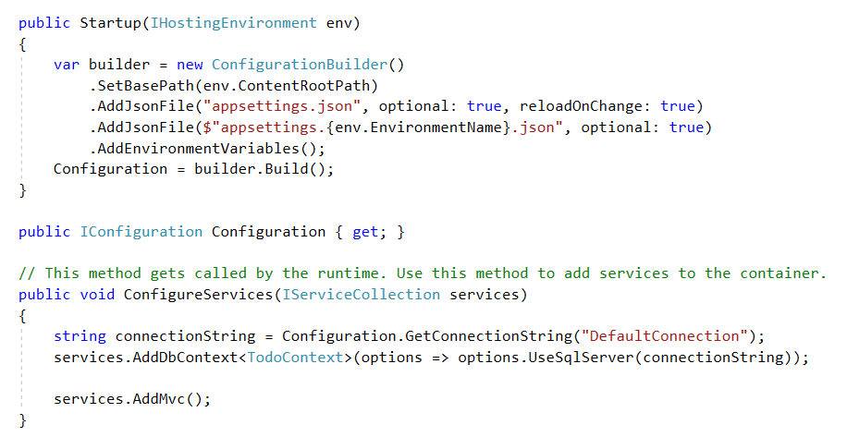

Slide 20
Add a controller
In Solution Explorer, right-click the Controllers folder. Select Add > New Item. In the Add New Item dialog, select the API Controller Class template. Name the class TodoController, and click Add.

Slide 21
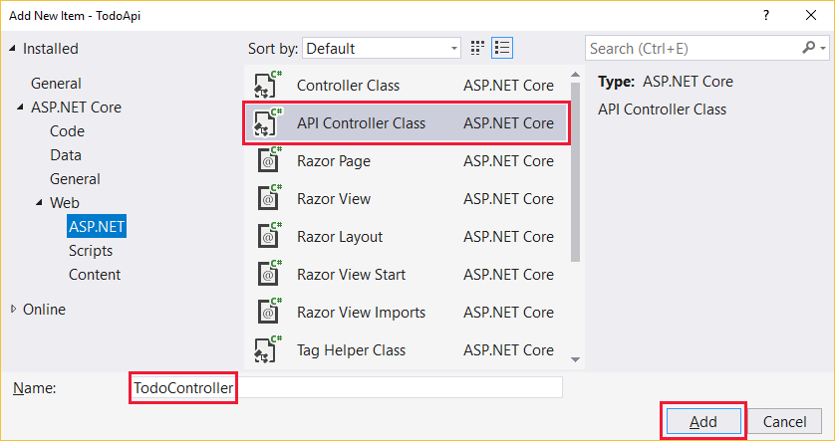

Slide 22
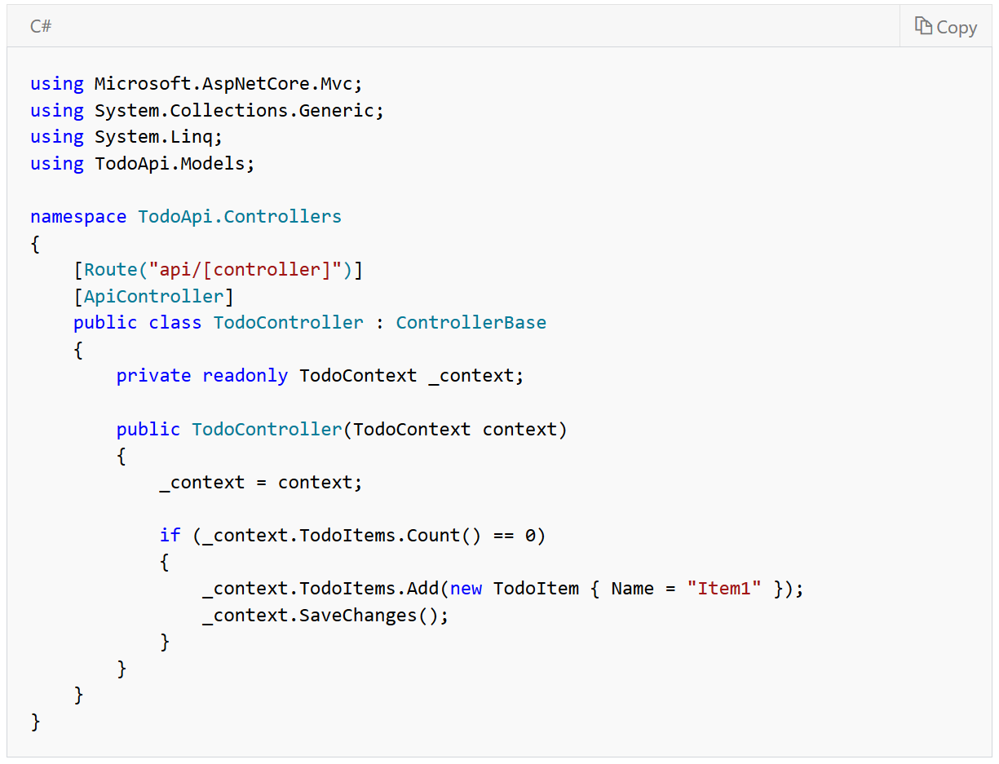

Slide 23
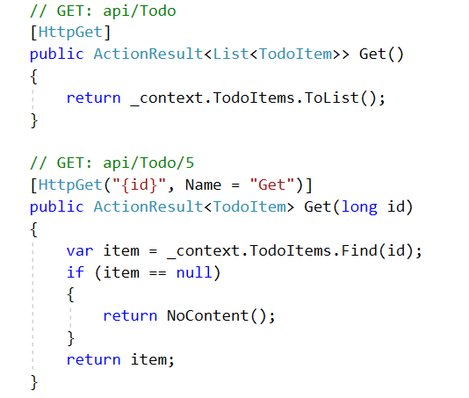
Get to-do items
To get to-do items, add the following methods to the TodoController class:
GET /api/todo
GET /api/todo/{id}

Slide 24
Implement the other CRUD operations
Create a new Todo
Update an existing Todo
Remove a Todo

Slide 25
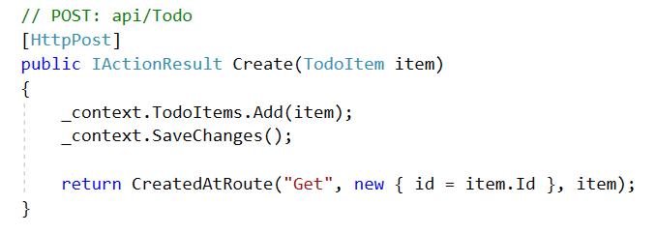
Create a new Todo

Slide 26
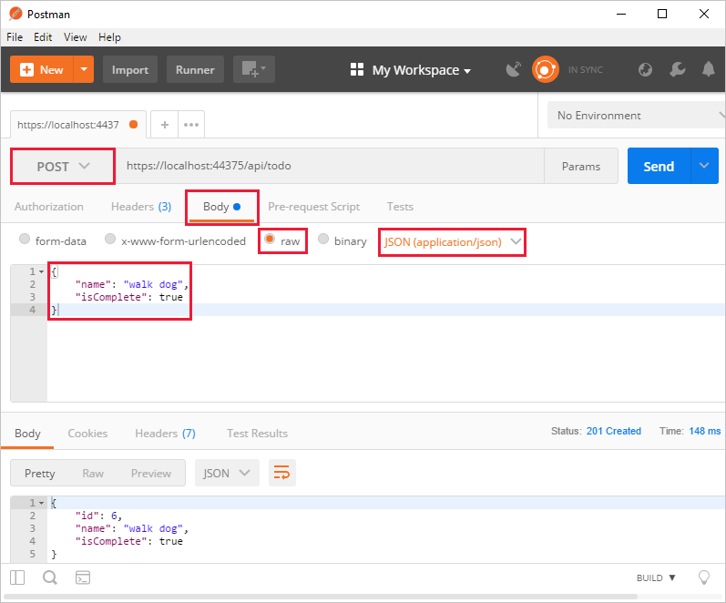

Slide 27
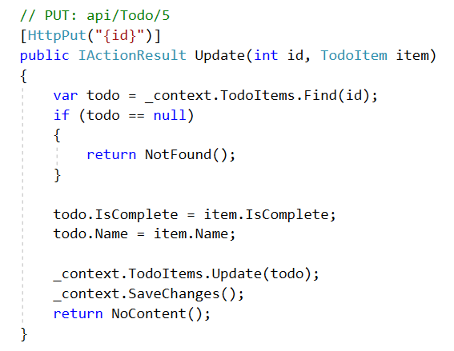
Update an existing Todo

Slide 28
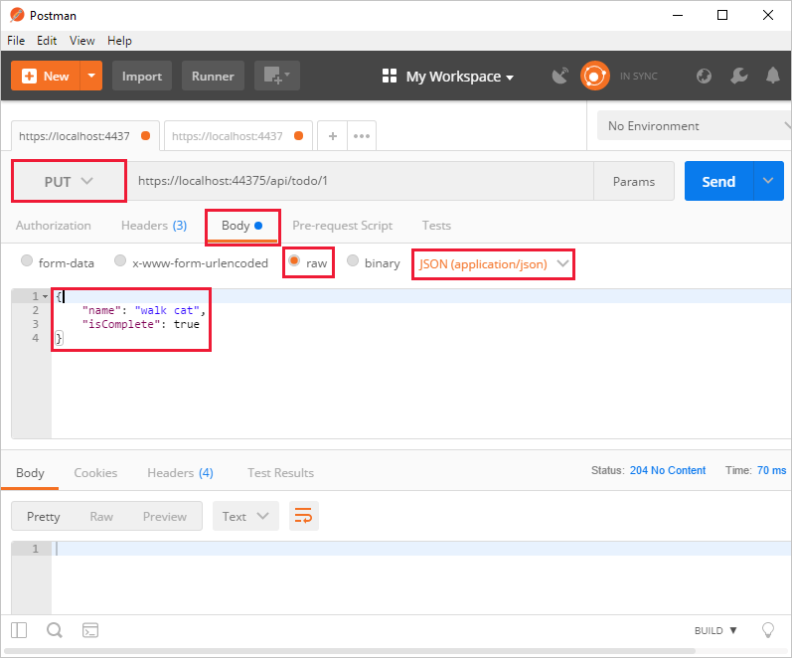

Slide 29
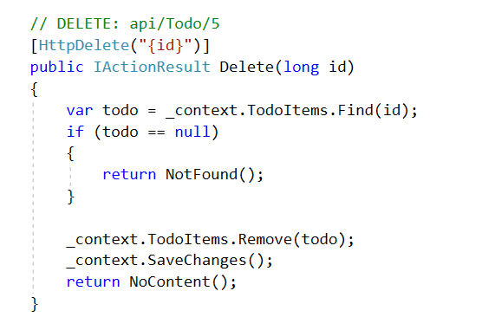
Remove a Todo

Slide 30
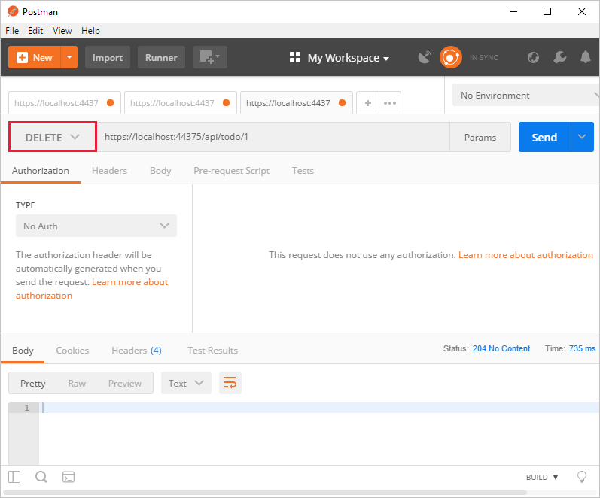

Slide 31
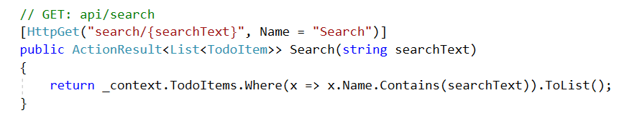
Search Data

Slide 32
THE END

